Slide 1

HATE CRIME IN THE US 2015-2020
Joseph Onwukeme • Kwadwo Asante
Yarely Vargas • Yvonne Martinez

Slide 2
Agenda
01
02
03
• About our data
• Research questions
• Design
• Website-Goal
• Website-Viz
• Website-About us
• Key Takeaway
• Closing remarks
• Future work

Slide 3
Our Data
What is Hate Crime?
Hate crime is defined as a crime motivated by bias against:
Race
Color
Religion
National Origin
Sexual Orientation
Gender
Gender Identity
Disability
What does our data include?
Our hate crime data comes from Kaggle. It was exported from the FBI hate crime site.
Our data includes information on incidents that occurred between 2015-2020.
Data we reported on included:
Offender Race,
Hate Bias Type,
Number of Victims,
Location of Incidents,
Type of Crime Committed

Slide 4
Research Questions
What is the most common hate crime in the US between 2015-2020?
What year had the most hate crime?
What state had the most hate crime incidents in 2020?

Slide 5

Design
Chose conservative fonts and colors
Filters to the right of dashboards since they are easier to find.
Filtered down to most current years 2015-2020 (less data = faster website response)
Bulk of data is categorical thus, used appropriate graphs to visualize data. (bar, lollipop, bubble)

Slide 6



WEBSITE WALK THROUGH
https://boojaado.github.io/group1-project3/website/index.html

Slide 7

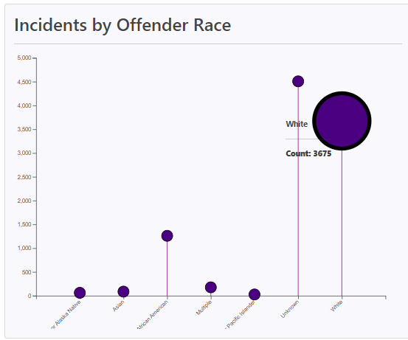
Key Takeaways
What race had the highest hate crime Offences in the US in 2020?
Race labeled as Other had the highest incidents of hate crime offences.
Second race with the highest hate crime Offences committed was White in 2020

Slide 8
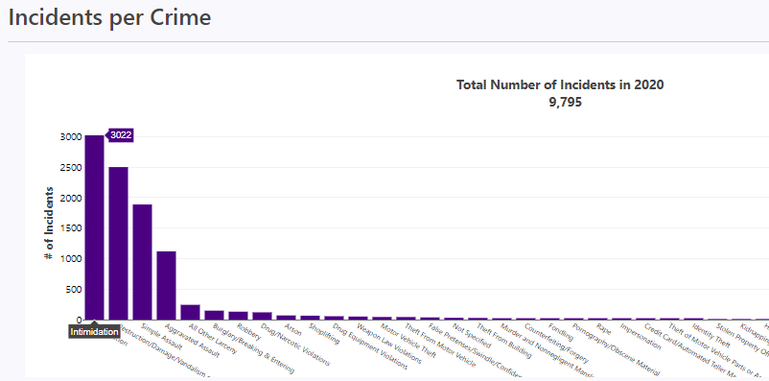
Key Takeaways
What year had the most hate crime incidents?
After going through the year filter, we found that 2020 had the most hate crime incidents occur.
Top two crimes with the most incidents were Intimidation and Destruction/Vandalism.

Slide 9
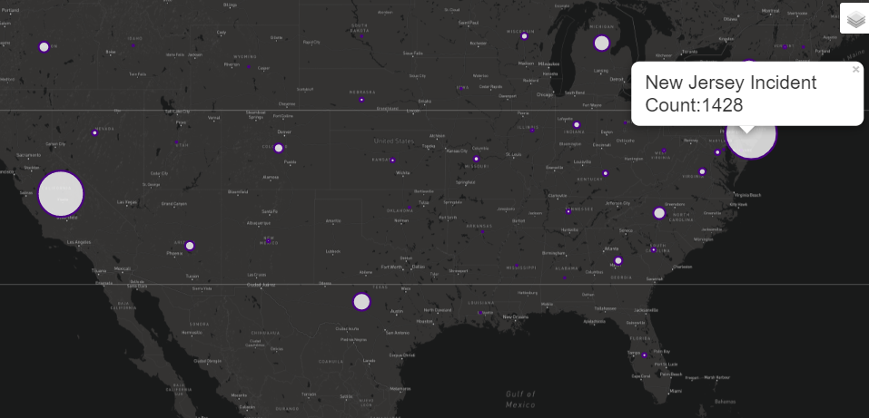
Key Takeaways
What state had the most hate crime incidents in 2020?
New Jersey had the highest number of hate crime incidents in 2020 with 1,428 incidents
California came second in high number of hate crime incidents in 2020 with 1,339

Slide 10
Future Work
Connect to an API to allow hate crime incidents to update & load automatically.
Map: ability to filter by hate crime bias or country & opening the map to include incidents worldwide.
Trend dashboard: showing hate crime incident trends as opposed to incidents per year.

Slide 11
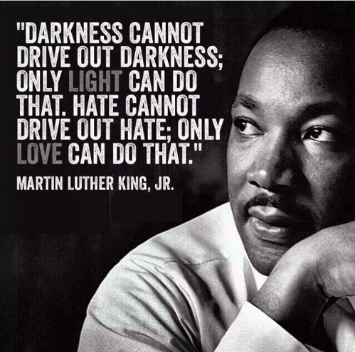

Slide 12

You can help!
More information on hate crime or to help stop hate crime in your community visit the justice.gov/hatecrimes

Slide 13
Citations
Hate crime info
https://www.justice.gov/hatecrimes/learn-about-hate-crimes
Images
https://www.theredcard.org/news/2016/08/17/a-worrying-trend-in-hate-crime-statistics
https://stlukesokc.org/inspiration/st-lukes-blogs/family-devotionals/darkness-cannot-drive-out-darkness/

Slide 14
THANK YOU

